Slide 1

Supermarket Sales Analysis Report
Tamilnadu

Slide 2
Total Sales: 14.96M
Total Profit Earned: $3.75M The store is earning an approximate 25% profit margin overall (3.75M profit on 14.96M sales).

Slide 3
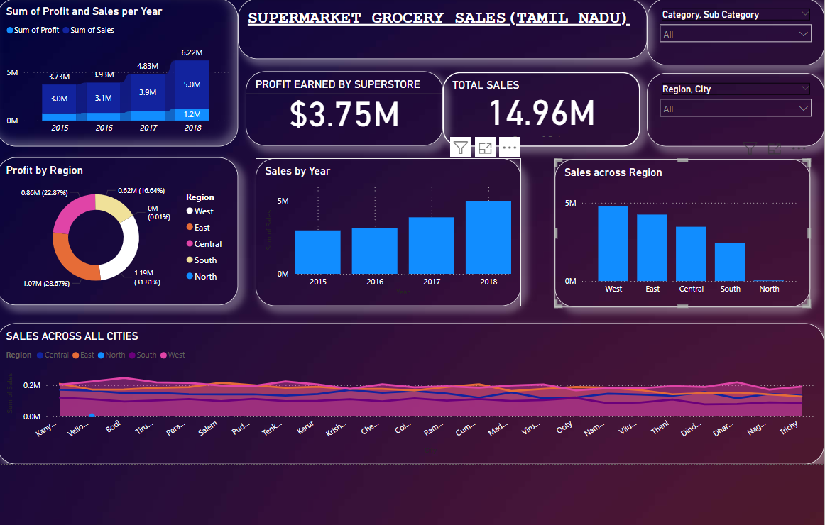
Supermarket Sales Analysis Report
Tamilnadu

Slide 4
Sales and Profit Trends (2015–2018): Sales Growth: Steady increase year-over-year. Jump from 3M (2015) to 6.22M (2018).

Slide 5
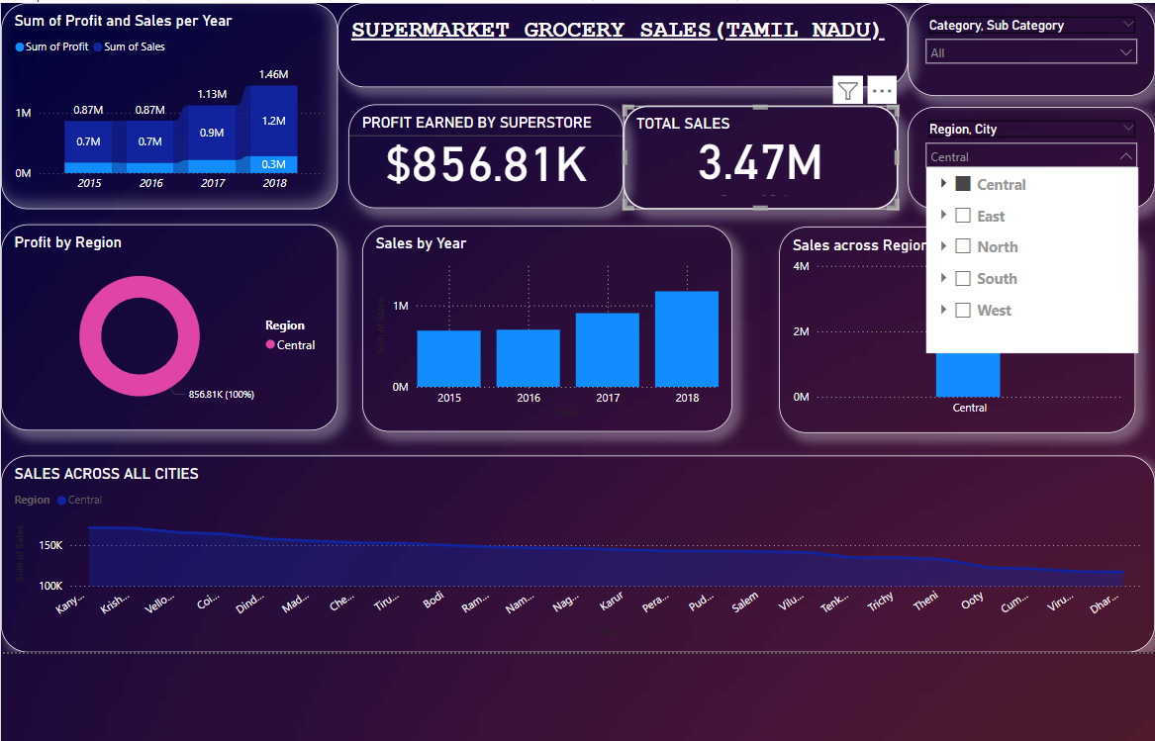
Supermarket Sales Analysis Report
Tamilnadu

Slide 6
Profit Growth: From 0.73M in 2015 to 1.2M in 2018. Profit trend roughly follows the sales growth pattern.

Slide 7
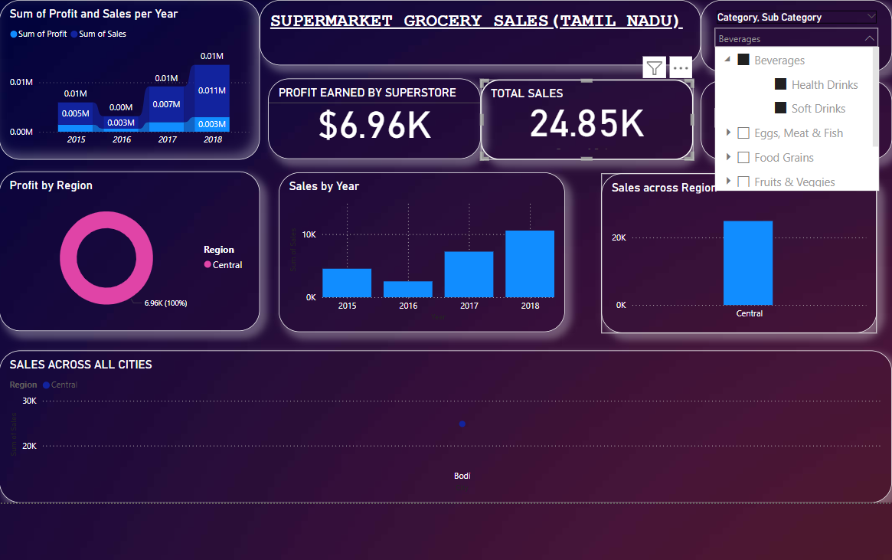
Supermarket Sales Analysis Report
Tamilnadu

Slide 8
Sales & Profit by Region: Top Performing Regions: West: Highest sales (~5M) and second highest profit (1.07M, 28.67%). North: Highest profit (1.19M, 31.81%) but lowest sales.

Slide 9
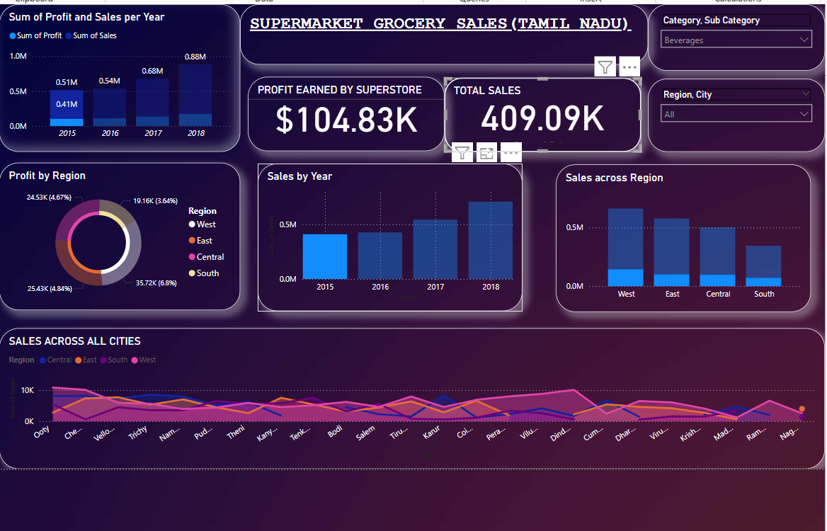
Supermarket Sales Analysis Report
Tamilnadu

Slide 10
Underperforming Region: North has almost zero sales but surprisingly shows the highest profit %. South and Central regions show mid-range sales with lower profit contributions.

Slide 11
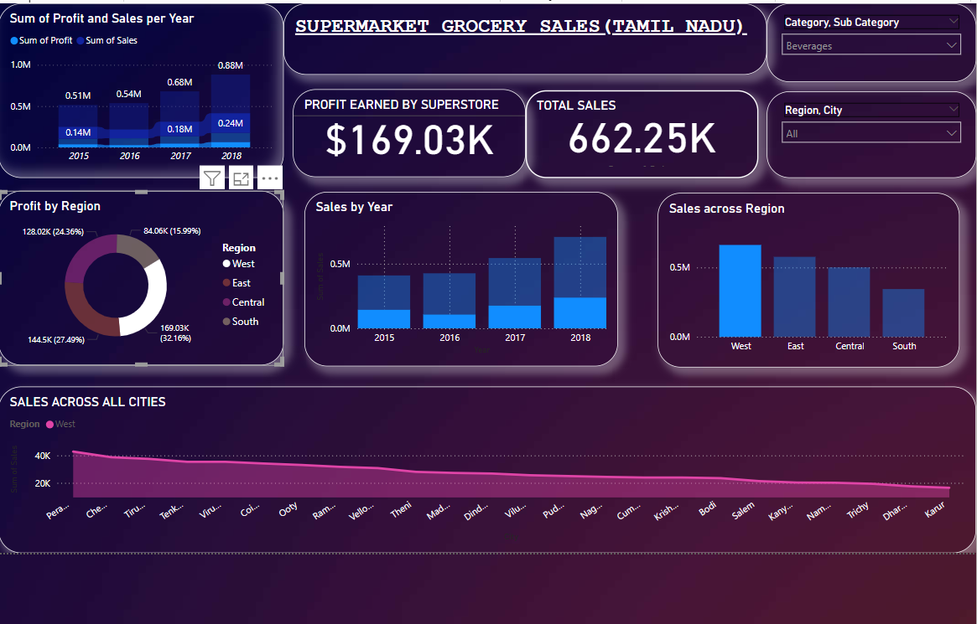
Supermarket Sales Analysis Report
Tamilnadu

